Slide 1


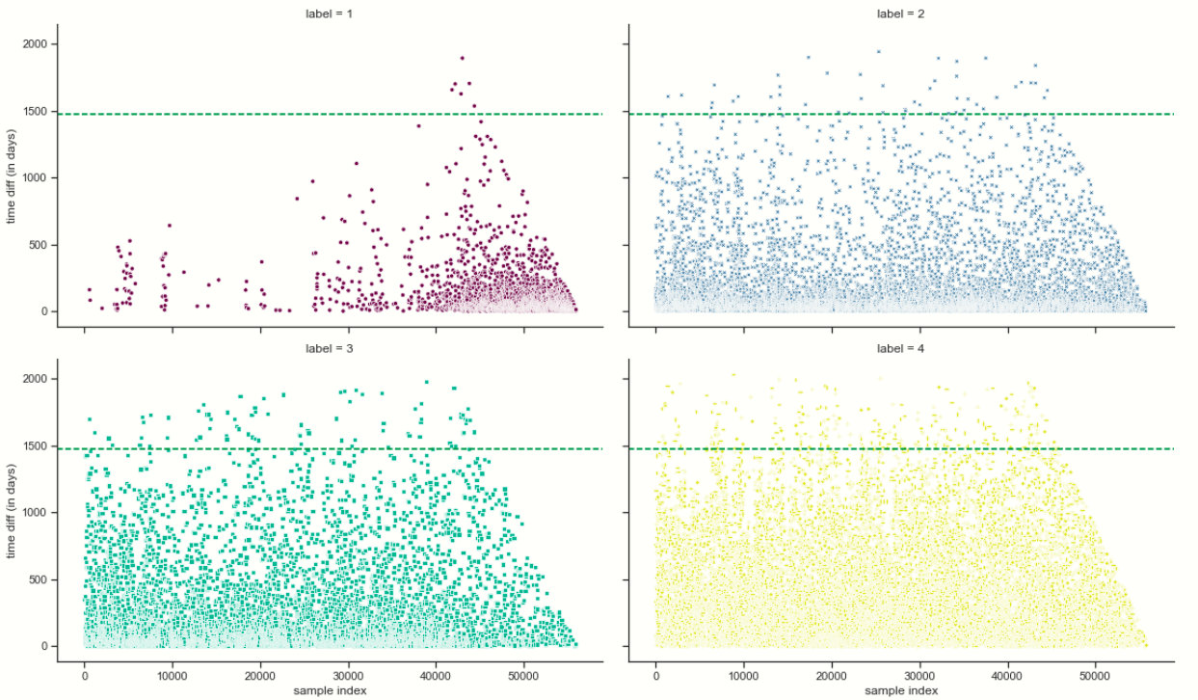
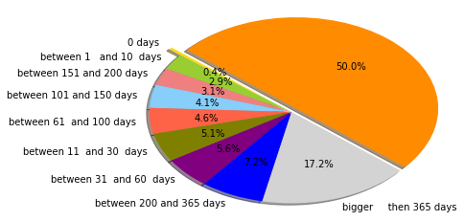
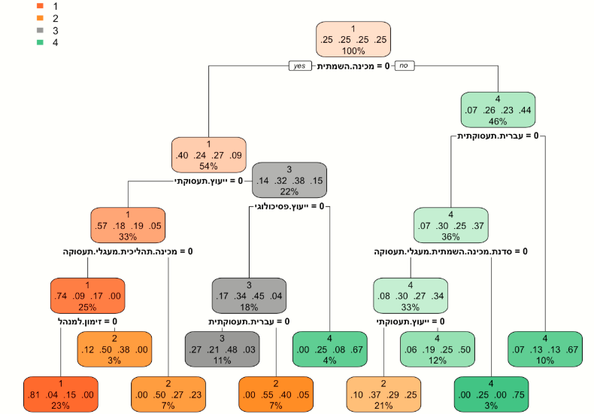
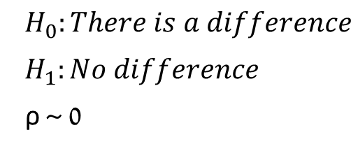
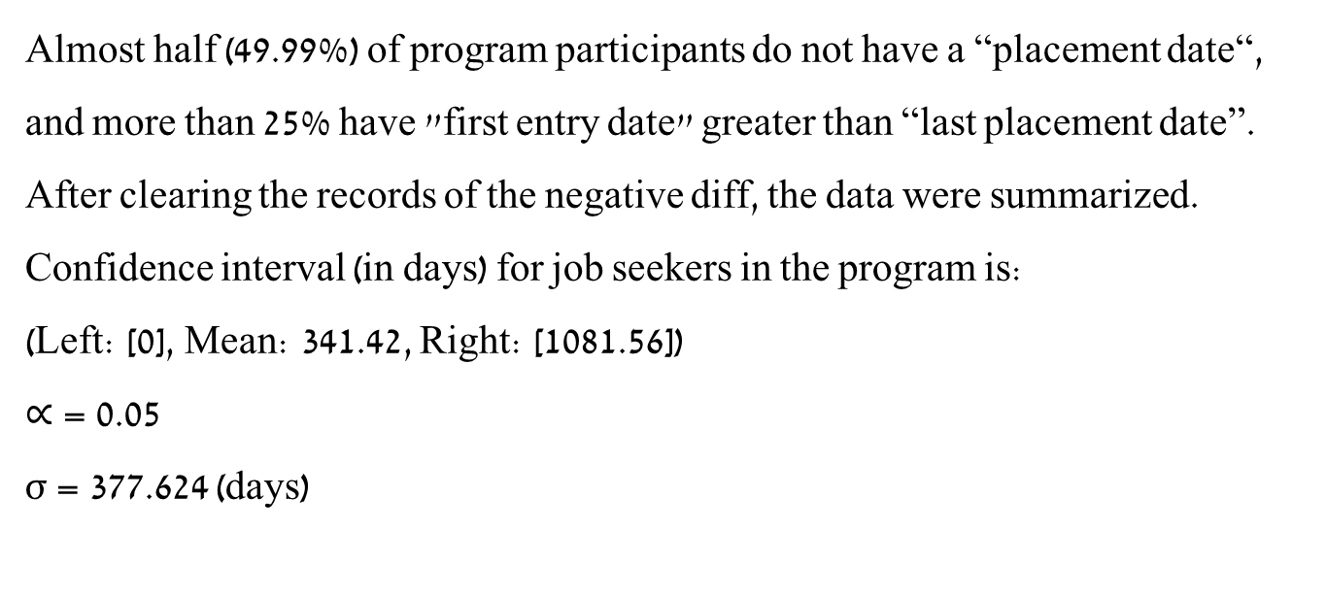
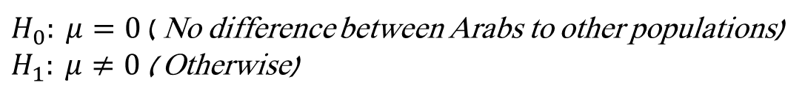
Analyzing the success factors of the Israel Employment Service placement program
Department of Industrial Engineering and Management
Israeli Employment Service Background
Project Goals
Literature Survey
The service provides job placements and brokerage for jobseekers.
Almost 60,000 jobseekers covering 71 bureaus all around Israel.
The IES provides professional training, finding employees for employers and more.
Israel with 3.8% unemployment rate (before the Covid-19 pandemic).
Analyzing success factors of the Israeli Employment Service “Employment Circuits” placement program
Write research paper and publish in Economic-Letters journal.
Present the article in the Economy & Business, 19th International Scientific Events Conference, 20-23 August 2020, Burgas, Bulgaria.
Higher local unemployment weakens the work norm (Winkelmann, 2014).
Making debts more manageable for unemployed on social assistance led to a significantly better chance to get back to work (Sol & Kok, 2014)
* The literature survey based on 30 references.
Analysis
Q1. Is there a difference between good placements of the Arabic population to other populations?
Placements Success Labels:
1) Amazing success
2) Medium success
3) Weak success
4) Failure
Method
Excel, SQL
Research Questions
$H_{0}: μ=0$ ( No difference between Arabs to other populations) $H_{1}: μ≠0$ ( Otherwise)
Data Collection
ρ = 0.097, therefore, the conclusion is to not reject the null hypothesis and conclude there is no significant difference between the job placement of the Arabs and the job placement of the non-Arabs.
Python, R
Python, R , SPSS
Data Factorizing
Modeling and Analyzing
Conclusions
Q2: How long job seekers are in the program before their placements ?
Q3: Is there a difference between the time length of jobseeker in the program to type of placement ?
Almost half (49.99%) of program participants do not have a “placement date“, and more than 25% have "first entry date" greater than “last placement date”. After clearing the records of the negative diff, the data were summarized. Confidence interval (in days) for job seekers in the program is: (Left: [0], Mean: 341.42, Right: [1081.56])
$∝$= 0.05
σ = 377.624 (days)
$$H_{0}:There is a difference$$
$$H_{1}:No difference$$
ρ ~ 0
Between all the mean pairs there are differences such that the means decreases with the decrease of the labels.
UCL = 1474.293
Q4: Do the number of activities from the program effects job seeker's placements ?
Q5: Is there an effect between socio-economic jobseeker characteristics to placement ?
There is a difference in the number of activities between the different types of successes (label), except for groups 2 and 3.
Decision tree model take a sample of jobseekers from the data frame and match their socioeconomic characteristics and activities to the data frame.
Multivariate regression model result (McFadden estimate) is 0.2368. Excellent fit in this model between 0.2 - 0.4 (McFadden,1977). All model results are compared to label 4 (failure) and each model result was displayed is significant (ρ < 0.05):
1) There are more Arab cities compered to Jewish cities in labels 1 and 2. Muslim and Jew religions significantly more to be in label 1. 2) The Soviet Union and France countries significantly more to be in label 3 than label 1 (compered by p-value). Ethiopia significantly more to be in label 2. 3) Education has a strong effect on the success label. Academic degree or high school matriculation has significantly more to be in label 1, and non-education significantly more to be in label 3.
4) Disability affects human life including program success. From 20%-59% significantly more to be in label 2 and 60%-100% to be in label 3, but no disability at all significantly more to be in label 2 and not 1 as we expected.
Conclusions & Recommendations
There is no difference between the placement of the Arabs and the placement of the non-Arabs. The IES needs to consider if there is justification to initiate special programs for the Arab community
The number of job seekers placed through the program is 50% which indicates a low rate of placements. This finding indicates the need for a study to clarify other reasons for poor job placement and compare to another placements programs results.
Longer the jobseeker being in the program, the quality of his placement (label) decreased. The IES should evaluate program activities and results.
There is an influence between socioeconomic characteristics of requiring work on the type of success in the program. The IES need to make a thorough statistical analysis on how job seekers are influenced by socio-economic characteristics.
Author: Shalev Chen Academic instructor: Dr. Pini Davidov

